Slide 1


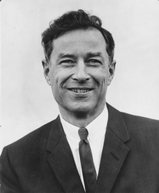
INTRODUCTION
BROWSE BY TYPE
BROWSE BY TAXONOMY
SEARCH
This collection of unusual specimen preparations, including freeze-dried displays of muscles, feet, tongues, and other anatomical parts, was created by Milton Hildebrand, Professor Emeritus, University of California at Davis, and a former MVZ graduate student. Hildebrand developed and perfected most of the anatomical techniques used in his specimen preparations, and many items in the collection are cross-referenced to laboratory exercises in vertebrate functional morphology courses that he designed. These unique and often delicate anatomical preparations makes them especially valuable for teaching, but also prohibits their availability for loans. Objects and models are organized by Type and Taxonomy.

Slide 2
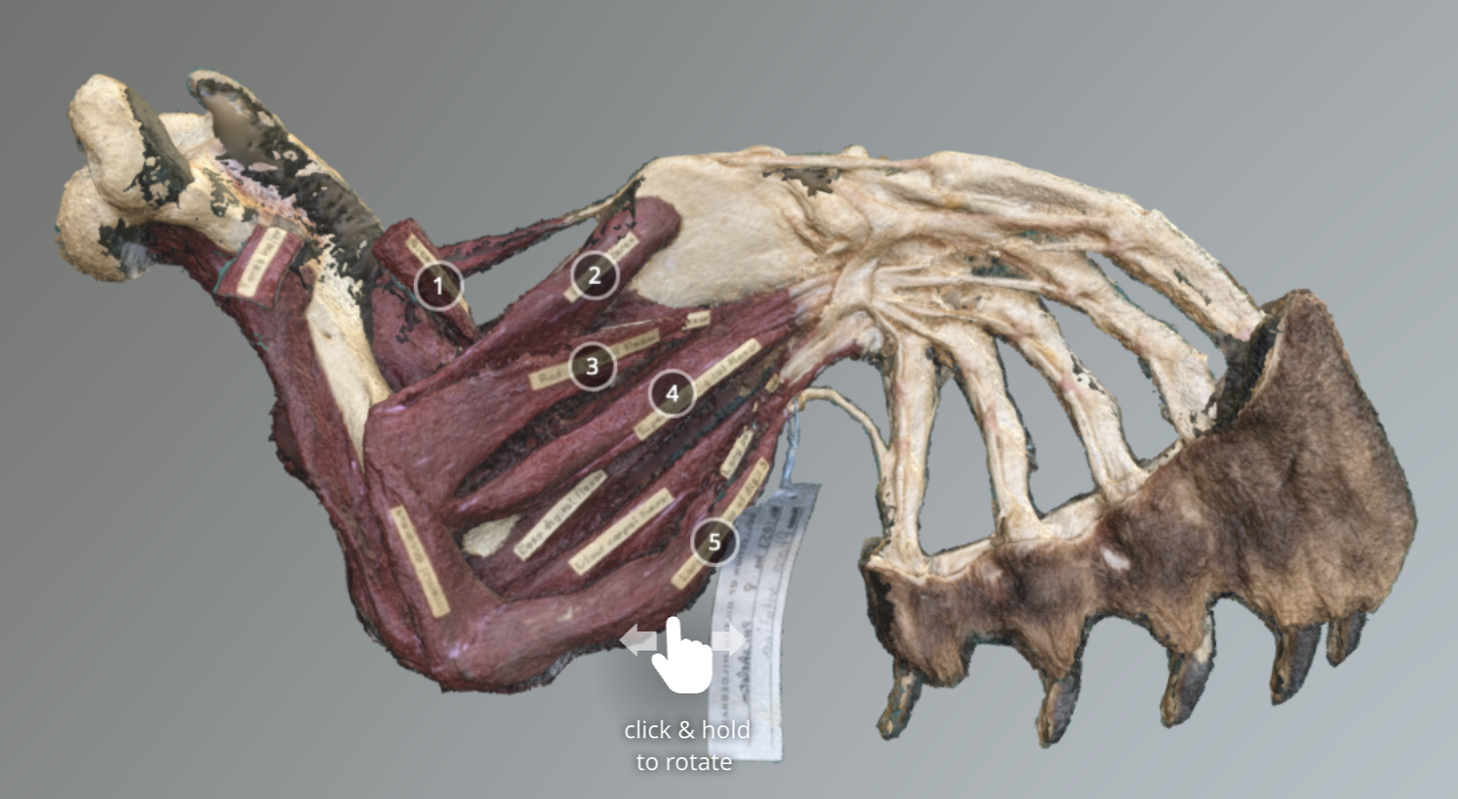
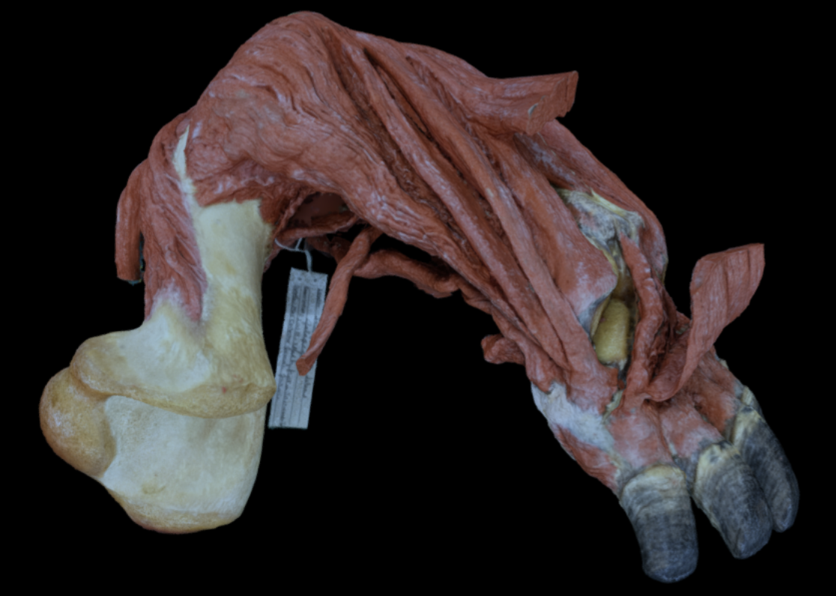
INTRODUCTION
BROWSE BY TYPE
BROWSE BY TAXONOMY
SEARCH
Forelimb Muscle Preps
Phoca vitulina
Geochelone elephantopus

Slide 3
INTRODUCTION
BROWSE BY TYPE
BROWSE BY TAXONOMY
SEARCH
CARNIVORA
PHOCIDAE
Phoca vitulina
FORELIMB BONE MUSCLE PREP
*
*
*
*
REPTILIA
TESTUDINIDAE
Geochelone elephantopus
FORELIMB BONE MUSCLE PREP

Slide 4
INTRODUCTION
BROWSE BY TYPE
BROWSE BY TAXONOMY
SEARCH
Phoca vitulina
FORELIMB BONE MUSCLE PREP

Slide 5
INTRODUCTION
BROWSE BY TYPE
BROWSE BY TAXONOMY
SEARCH
Phoca vitulina
FORELIMB BONE MUSCLE PREP
Model view page. Navigation tools? Link out to Sketchfab?

